Slide 1


Syrian Private University (SPU)
FACULTY OF ARTIFICIAL INTELLIGENCE ENGINEERING, CONTROL AND ROBOTICS ENGINEERING DEPARTMENT
perfume bottle filling production line
SUPERVISORS
PREPARED BY
Dr. Samer Hussam Eddin | Eng. Shadi Saab
Mhd Anas Ghiath Fakhani

Slide 2


PROJECT FRAMEWORK
General Introduction to the project framework
Small-Scale Industrial Bottling
scope
Small to medium liquid bottling enterprises (perfumes, pharmaceuticals, beverages) require precise dispensing without investing in expensive, large-scale industrial PLCs.
In-Scope Operations: Conveyor belt motion control, precise bottle positioning and size, filling process management.
Out-of-Scope Operations: Bottle feeding at the start of the conveyor (manual loading), bottle capping/sealing, and removing filled bottles at the end of the line (manual unloading).

Slide 3
LITERATURE REVIEW (PART 1)
Recent State-of-the-Art Research
Malleswari et al. (2022)
Gegan pandey et al. (2025)
"Automatic Bottle Filling System Using Arduino" (IJARTET)
"Automated Bottle filling and capping plant"
Architecture: Arduino Mega 2560 + IR Sensors + 16x2 LCD + dc motor + dc pump +driver.
Architecture: Raspberry Pi 4 + arduino uno + IR + limit switches + usb webcams + NEMA 17 stepper + servo MG996R + DC 12V PUMP
Dosing Strategy: Time-delay based open-loop DC pump control.
Dosing Strategy: time-based filling (open-loop) + visual verification + refilling upon underfill detection.
Limitation: Lacks flow feedback
Limitation: works only with transparent bottles

Slide 4
COMPARATIVE BENCHMARKING
Comparative Table of Studied Papers
Feature | Malleswari (2022) |  | Pandey (2025) | Proposed System
Controller | Arduino Mega 2560 |  | Raspberry Pi 4 + UNO | Options: Arduino, esp32, plc
Detection | IR Sensor Pair |  | 1080p Webcams (Vision) | HC-SR04 Ultrasonic
Dosing Method | Timed DC Pump |  | Camera Edge Detection | YF-S201 Flow Sensor Pulses
User Interface | 16x2 Character LCD |  | MQTT Dashboard | Nextion 3.5" Touch Screen
Control Loop | Open Loop (Timed) |  | Vision Feedback | Open loop for the belt, Closed Loop For filling,
Accuracy / Error | Uncalibrated drift |  | 97% Precision | ±5% Fill Accuracy

Slide 5
GOAL HIERARCHY
Project Main & Secondary Objectives
Main Objectives
1. To design and develop a low-cost automated bottle filling system suitable for small-scale industries
2. To achieve accurate fill volumes
3. Reduce operational costs and labor dependence.
CORE PROJECT DELIVERABLE

Slide 6
SYSTEM PARAMETERS
Technical Specification Table
Subsystem Module | Component / Technology
Microcontroller Unit | Arduino, esp32, plc
Filling way | pump
Bottle Detection | HC-SR04 Ultrasonic Sensor, level sensor
Actuation & Valve | 12V Solenoid Valve & Relay Unit
Conveyor Drive | Stepper, dc, servo

Slide 7
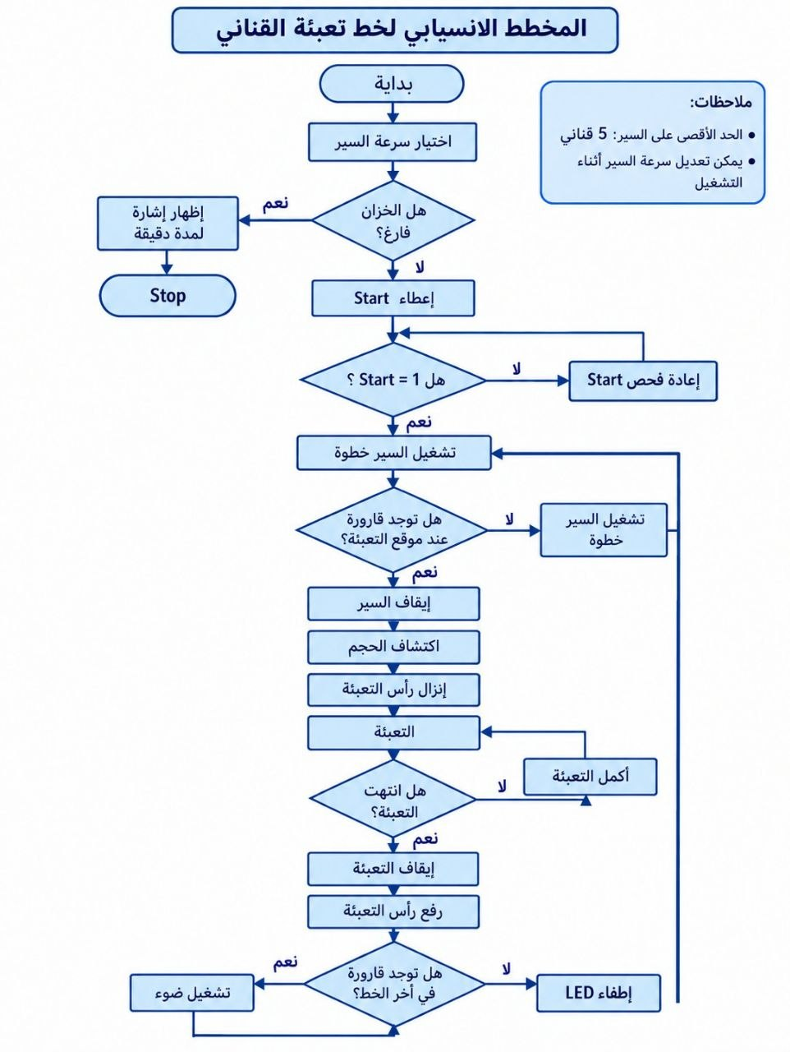

Slide 8
TIMELINE & IMPLEMENTATION
Project Implementation Time Schedule
Phase / Task Description | Responsible Lead | Timeframe | Key Deliverables
System Architecture & Literature Review | Systems Lead | Weeks 1 – 2 | block diagram, flow chart
Hardware Component Procurement | Hardware Team | Weeks 3 – 4 | Sensors, motors & valves
Mechanical Frame & Conveyor Fabrication | Mechanical Lead | Weeks 5 – 7 | Chain belt conveyor & bottle pads
software coding | Software Lead | Weeks 8 – 10 | Arduino C++ sketch
Testing | QA & Integration Lead | Weeks 11 – 12 | Final validation report

Slide 9


Discussion
Syrian Private University (SPU)
info@spu.edu.sy

